Slide 1

Social Buzz Data Analysis

Slide 2
Today's agenda
Project recap
Problem
Analytics team
Process
Insights
Summary

Slide 3
Project Recap
Social Buzz is a global unicorn technology company growing at an accelerated rate. Accenture has embarked in a 3 month work pilot to help tackle their biggest challenges which include:
Audit of Social Buzz Big data practice
Implementation of an IPO
Analysis of top 5 popular categories content

Slide 4

Problem
Social Buzz has reached over 100,000 posts per day which take us to 36,500,000 pieces of content per year!
But how do we capitalize on it when there is so much?

Slide 5
The Analytics Team
Andew Fleming
Chef Technical Architect
Marcus Rompton
Senior Data Expert
Sigrid N.
Data Analyst

Slide 6
Process
Understanding problem
Data Extraction
Data Cleaning
Data Analysis
Data Visualization to uncover insights
1
2
3
4
5

Slide 7
After carefully reviewing and understanding the project requirements, the CSV files were loaded into Excel followed by SAS for processing.
Data cleaning was performed, missing values were handled, erroneous & duplicate entries were removed. The datasets reactions, reaction type, and content were merged based on key values prior the analysis, data visualization was carried out using Tableau software.

Slide 8
Insights
Unique Categories
16
The analysis results shows 16 categories of post across the entire dataset. There was 1969 animals posts alone telling us there are lots of animals lover out there. The result also shows January scored the highest number of posts of 2218 which is interesting to see how active people are even after the big holidays season.
Reactions to "animals"
1969
Month with highest posts
January

Slide 9
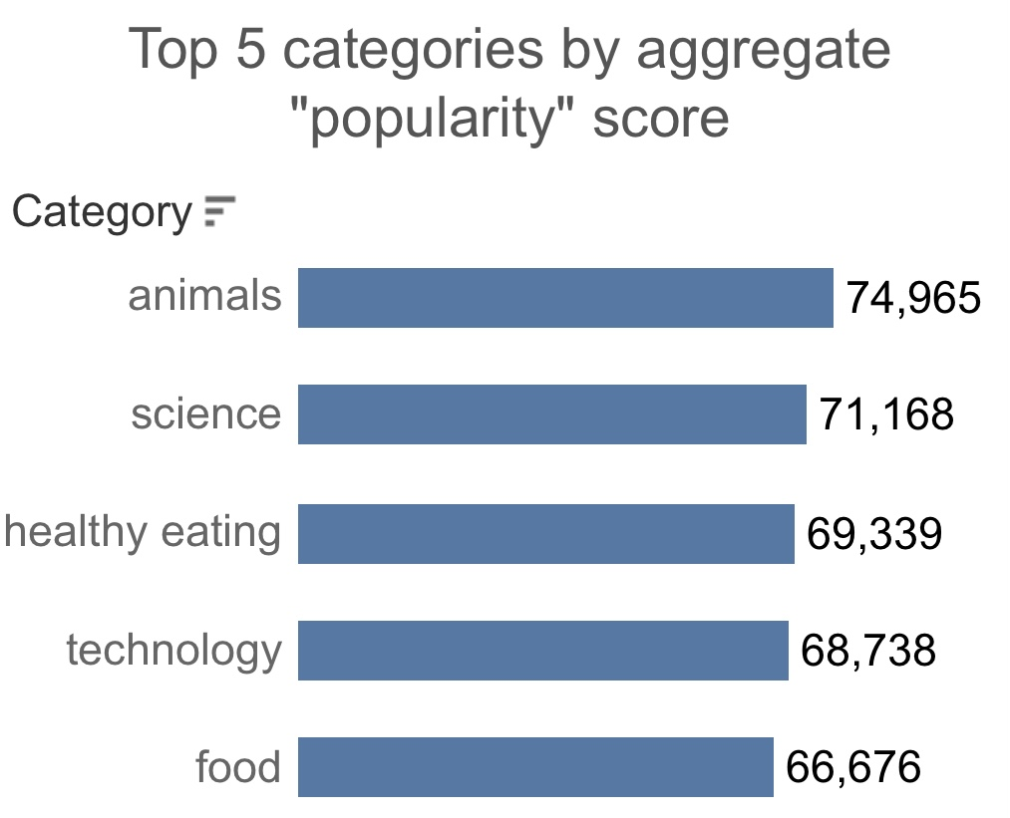
The top 5 most popular categories of content were animals, science, healthy eating, technology, and food. Animals had an aggregate popularity score of 74,965.
It's fascinating to see both animals and science within the top 5, this shows that people like seeing real-life content the most. No wonder healthy eating made it to the top 5 as many people are very keen when it comes to making healthy choices.

Slide 10
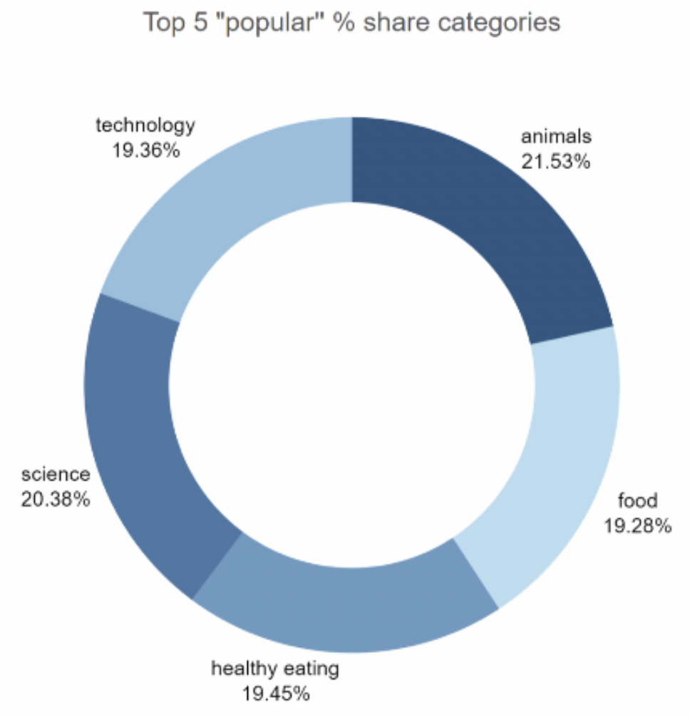
We can see that there isn't a big difference from the chart split between popularity of the top 5 categories. The first largest percentage animals outperformed the second largest one science by 1.1%.

Slide 11
Summary
Animals and science were two of the most popular content categories with healthy eating ranking as the third one. We recommend creating more content related to those categories to boost user engagements.
Healthy eating can be placed in same category as "food". We suggest collaborating with healthy food brands to help bring brand awareness and to reach wider audience.
With this technology age, there is no surprise to see technology in top 5 categories. It shows that users enjoy tech contents. Collaborating through brands partnership with tech companies will definitely increase engagement rates.

Slide 12
As much as this analysis was insightful, we are ready to take it to the next stage and we have expertise within Accenture to help you realize these kinds of insights in production across your organization and in real time. We would love to help you with this.

Slide 13
Thank you!
Any questions?

